Slide 1

Blockchain Technology in 5G Spectrum
CS473 | BLOCKCHAIN TECHNOLOGY & APPLICATIONS
Supervisor
Prof. Khushi Patel
Prof. Rima Patel
18DCS007 - RUDRA BARAD
18DCS024 - HET GALIA
18DCS030 - MANAN JOSHI
7CSE1

Slide 2
Topics of Presentation
01
04
5G Spectrum
Blockchain
02
Applications of 5G Spectrum
05
5G enabled Blockchain
03
Limitations of 5G Spectrum
06
Plan of action
07
References

Slide 3
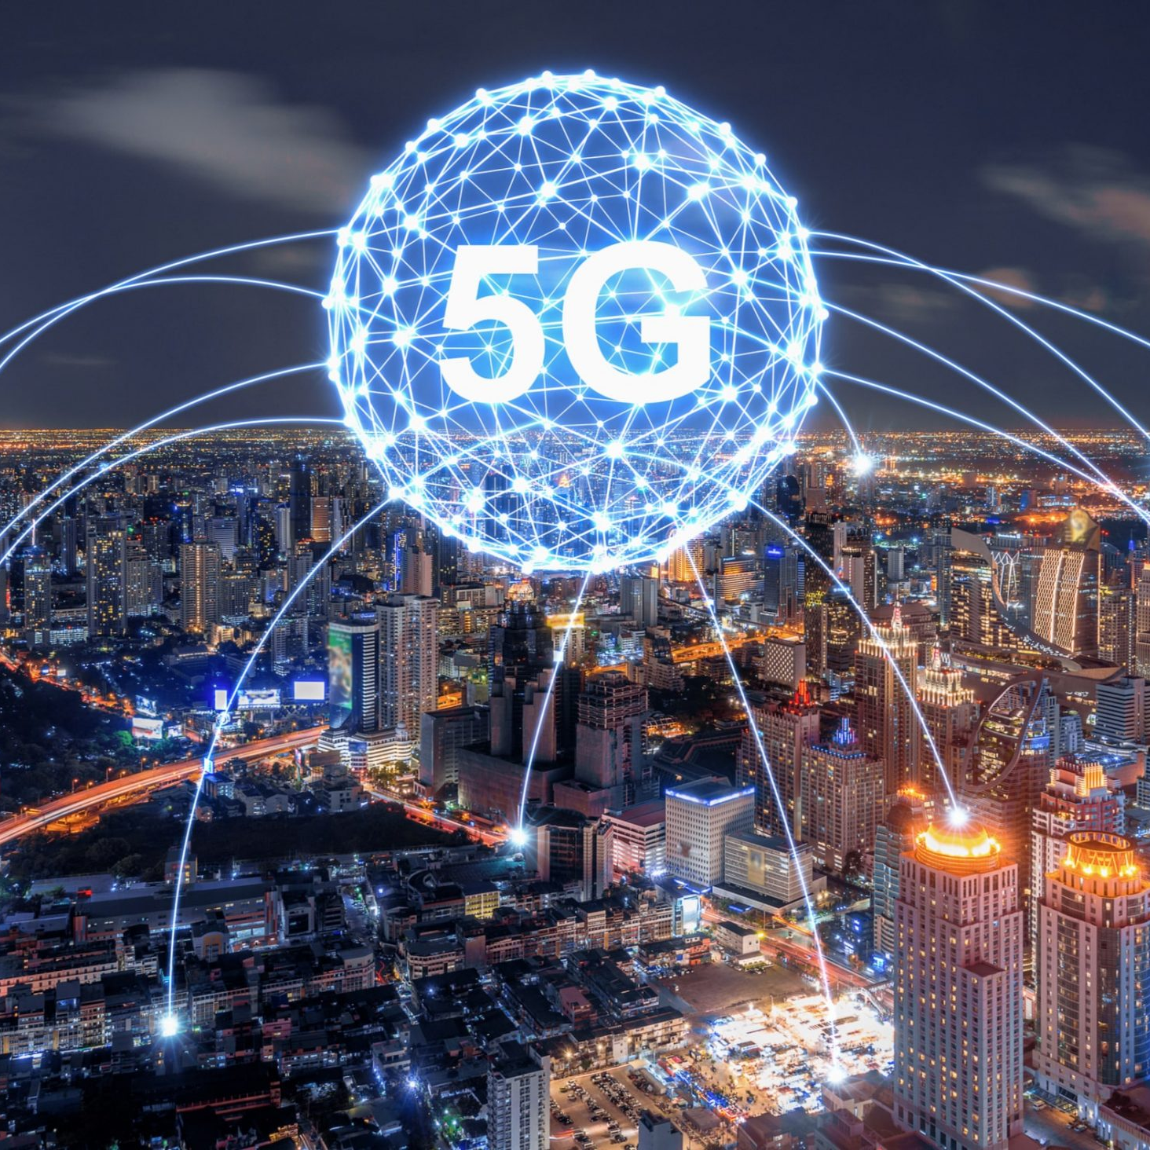
5th Generation
5G is the fifth generation technology standard for broadband cellular network
5G is not only important because it has the potential to support millions of devices at ultrafast speeds, but also because it has the potential to transform the lives of people around the world.

Slide 4


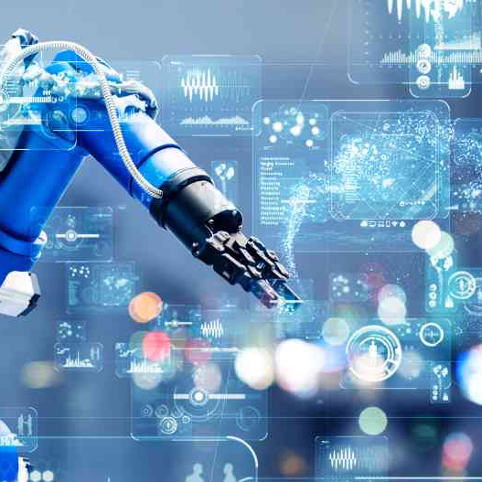
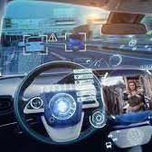
Applications of 5G
last
Entertainment & Multimedia
first
second
last
Healthcare
Transport Automation
Manufacturing
And the list goes on….

Slide 5
3 Billion
5G subscriptions worldwide by 2024

Slide 6
Limitations of 5G spectrum:
5G works on high frequency radio waves, as a result of which they can traverse only short distances.
Added to this setback is the fact that 5G frequency is interrupted by physical obstructions such as trees, towers, walls and buildings.
To counter this setback, we can think of extending existing cell towers or setting up more and more towers at shorter distances. But this is not feasible/ practical solution.
This is where Blockchain comes into the picture.

Slide 7


Blockchain
A blockchain is a public digital ledger of transactions that records information in a way that makes it difficult to hack or alter.
Blockchain network can allow P2P communication with the base stations in 5G network and relay network performance data for Self Organizing Networks(SON) setup to optimize radio access network

Slide 8
It has its application in varied sectors.
Iot is one such sector where it can be of real use.
5G enabled Blockchain
Smart city
To enable services such as payments, e-Governance, security, and surveillance
01
Automation
Applications like smart home monitoring, energy optimization, & surveillance.
02
03
Decision & Data analytics
It can be used for predictive and descriptive analysis
Notes:
It can be used for predictive and descriptive analysis to improve customer knowledge, enhance efficiency, & create business value.
Blockchain IoT solutions are increasingly being used in smart cities to enable the services such as payments, e-Governance, security, and surveillance of the smart cities

Slide 9
Roadmap
Challenges in implementing 5G enabled Blockchain
Reviewing and comparing different research papers.
Conclusion and submitting review paper so that it could be reviewed by others.
2
4
6
Getting insights about 5G enabled Blockchain
Preparing a proper summary table of all the reviewed research papers.
Presenting our case study
1
3
5

Slide 10
References
https://medium.com/@vsevindik/blockchain-applications-in-5g-33457b64dea5
https://researchwith.njit.edu/en/publications/blockchain-based-framework-for-modeling-and-evaluating-5g-spectru
https://www.researchgate.net/publication/335518169_Blockchain_for_5G_Opportunities_and_Challenges
https://www.sciencedirect.com/science/article/abs/pii/S1084804520301673
https://blockchain.ieee.org/images/files/pdf/201912-blockchain-for-5g_-_k-salah.pdf
http://ijiser.com/paper/2021/vol8issue3/Mar2021p103.pdf
https://www.researchgate.net/publication/341674743_Blockchain_for_5G_and_Beyond_Networks_A_State_of_The_Art_Survey
https://www.blockchain-council.org/blockchain/blockchain-transforms-5g-opportunities-and-challenges

Slide 11
Thank
You

